Slide 1


Shun OSAWA
2024-05-20

Slide 2

Outline
Executive Summary
Introduction
Methodology
Results
Conclusion
Appendix

Slide 3
Executive Summary
Summary of methodologies
Data Collection through API
Data Collection with Web Scraping
Data Wrangling
Exploratory Data Analysis with SQL
Exploratory Data Analysis with Data Visualization
Interactive Visual Analytics with Folium
Machine Learning Prediction
Summary of all results
Exploratory Data Analysis result
Interactive analytics in screenshots
Predictive Analytics result

Slide 4
Introduction
Project Background and Context
In this capstone project, we aim to predict the successful landing of SpaceX's Falcon 9 rocket's first stage. SpaceX advertises Falcon 9 rocket launches on their website at a cost of $62 million per launch, significantly lower than the $165 million or more charged by other providers. A major contributor to this cost difference is SpaceX's ability to reuse the first stage of the rocket. Predicting these landing outcomes is crucial as it directly impacts the overall cost of a launch. Understanding these dynamics is beneficial for potential competitors who might want to challenge SpaceX in rocket launch bids. This project will develop a machine learning model that integrates various data inputs and historical launch data to predict the probability of a successful landing for the Falcon 9's first stage.
Problems You Want to Find Answers
Determinants of Landing Success: What are the critical factors that influence whether the Falcon 9's first stage will land successfully? This involves identifying and analyzing various technical and environmental parameters that could affect the landing outcome.
Feature Interactions: How do various features interact to influence the probability of a successful landing? Understanding these interactions will help in fine-tuning the predictive model to enhance its accuracy and reliability.
Optimal Operating Conditions: What are the necessary operating conditions to ensure a successful landing program? This question seeks to define the optimal parameters and conditions under which the Falcon 9's first stage has the highest probability of a successful landing, thereby guiding operational decisions and pre-launch preparations.

Slide 5

Section 1

Slide 6
Methodology
Executive Summary
Data collection methodology:
Data was collected using SpaceX API and web scraping from Wikipedia.
Perform data wrangling
One-hot encoding was applied to categorical features
Perform exploratory data analysis (EDA) using visualization and SQL
Perform interactive visual analytics using Folium and Plotly Dash
Perform predictive analysis using classification models
Building, tuning, and evaluating classification models involves preparing data, selecting and training models, optimizing via hyperparameter tuning, assessing with metrics like accuracy and ROC-AUC, and iteratively improving for deployment.

Slide 7
Data Collection
The data was collected using various methods
Data collection was done using get request to the SpaceX API.
Next, we decoded the response content as a Json using .json() function call and turn it into a pandas dataframe using .json_normalize().
We then cleaned the data, checked for missing values and fill in missing values where necessary.
In addition, we performed web scraping from Wikipedia for Falcon 9 launch records with BeautifulSoup.
The objective was to extract the launch records as HTML table, parse the table and convert it to a pandas dataframe for future analysis.

Slide 8
Data Collection – SpaceX API
Present your data collection with SpaceX REST calls using key phrases and flowcharts
Add the GitHub URL of the completed SpaceX API calls notebook (must include completed code cell and outcome cell), as an external reference and peer-review purpose

Slide 9
Data Collection - Scraping
Present your web scraping process using key phrases and flowcharts
Add the GitHub URL of the completed web scraping notebook, as an external reference and peer-review purpose

Slide 10
Data Wrangling
Describe how data were processed
You need to present your data wrangling process using key phrases and flowcharts
Add the GitHub URL of your completed data wrangling related notebooks, as an external reference and peer-review purpose

Slide 11
EDA with Data Visualization
Summarize what charts were plotted and why you used those charts
Add the GitHub URL of your completed EDA with data visualization notebook, as an external reference and peer-review purpose

Slide 12
EDA with SQL
Using bullet point format, summarize the SQL queries you performed
Add the GitHub URL of your completed EDA with SQL notebook, as an external reference and peer-review purpose

Slide 13
Build an Interactive Map with Folium
Summarize what map objects such as markers, circles, lines, etc. you created and added to a folium map
Explain why you added those objects
Add the GitHub URL of your completed interactive map with Folium map, as an external reference and peer-review purpose

Slide 14
Build a Dashboard with Plotly Dash
Summarize what plots/graphs and interactions you have added to a dashboard
Explain why you added those plots and interactions
Add the GitHub URL of your completed Plotly Dash lab, as an external reference and peer-review purpose

Slide 15
Predictive Analysis (Classification)
Summarize how you built, evaluated, improved, and found the best performing classification model
You need present your model development process using key phrases and flowchart
Add the GitHub URL of your completed predictive analysis lab, as an external reference and peer-review purpose

Slide 16
Results
Exploratory data analysis results
Interactive analytics demo in screenshots
Predictive analysis results

Slide 17

Section 2

Slide 18
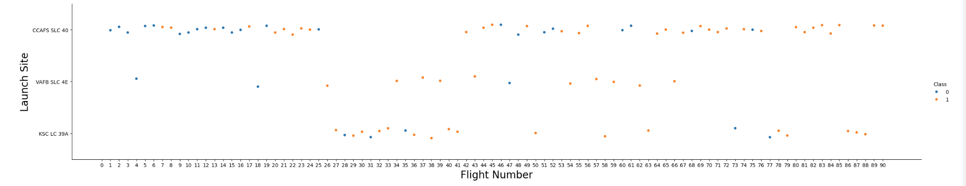
Flight Number vs. Launch Site
Show a scatter plot of Flight Number vs. Launch Site
Show the screenshot of the scatter plot with explanations

Slide 19
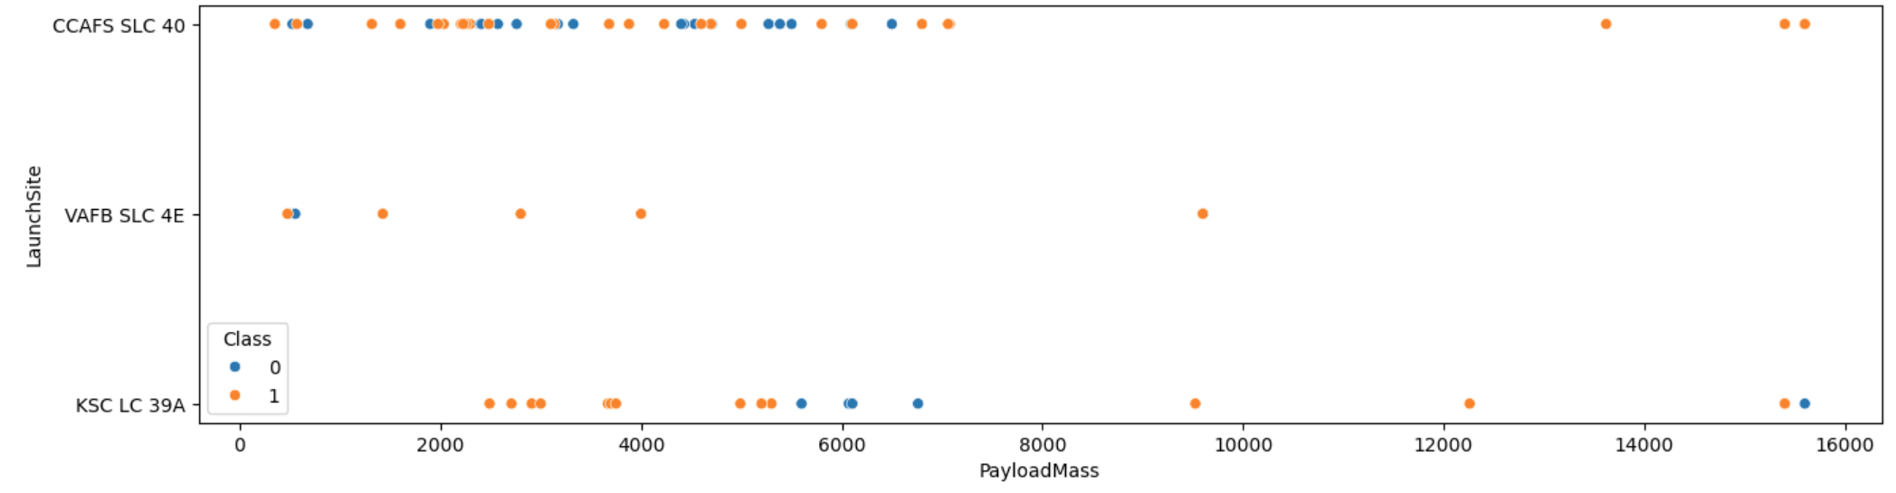
Payload vs. Launch Site
Show a scatter plot of Payload vs. Launch Site
Show the screenshot of the scatter plot with explanations

Slide 20
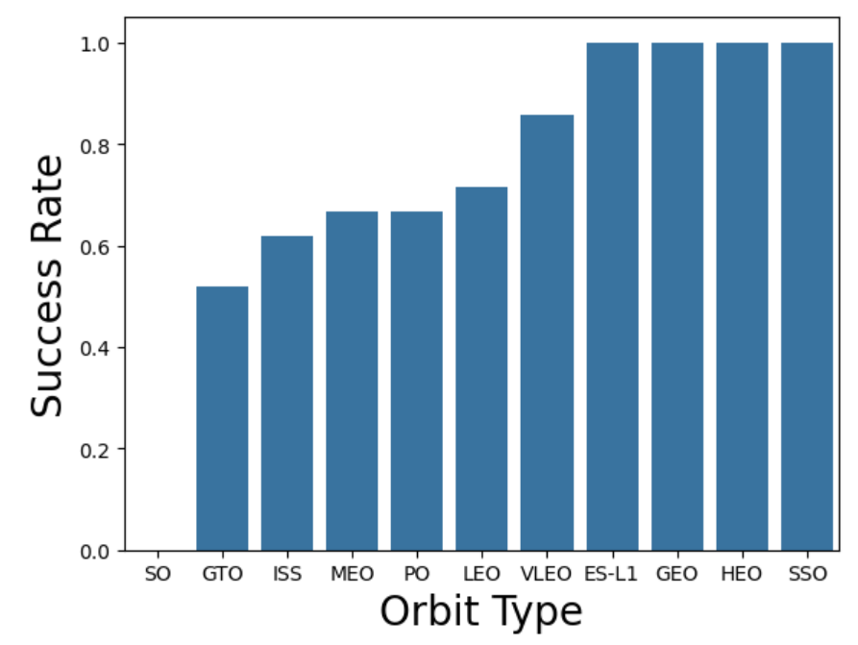
Success Rate vs. Orbit Type
Show a bar chart for the success rate of each orbit type
Show the screenshot of the scatter plot with explanations

Slide 21
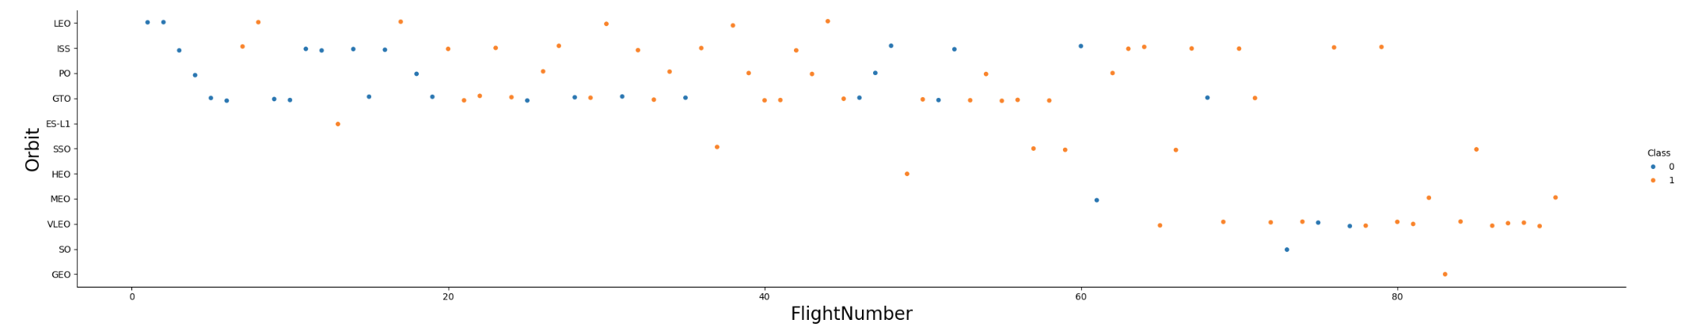
Flight Number vs. Orbit Type
Show a scatter point of Flight number vs. Orbit type
Show the screenshot of the scatter plot with explanations

Slide 22
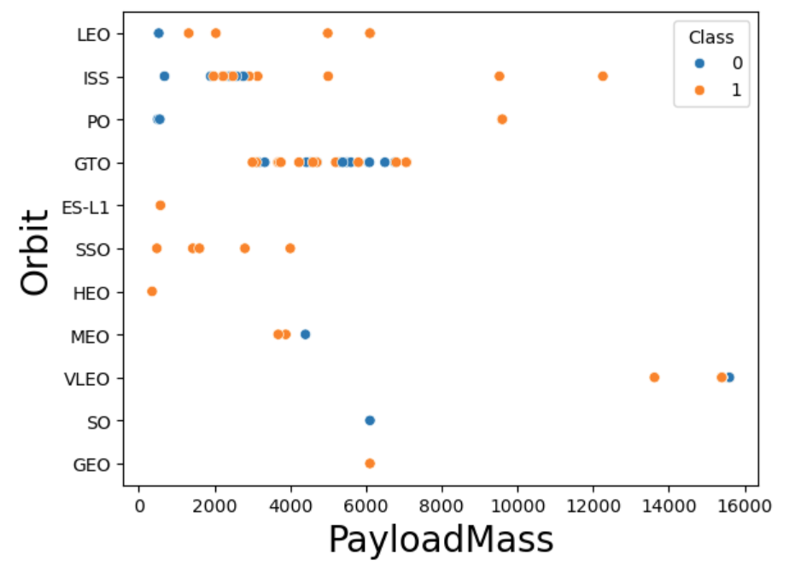
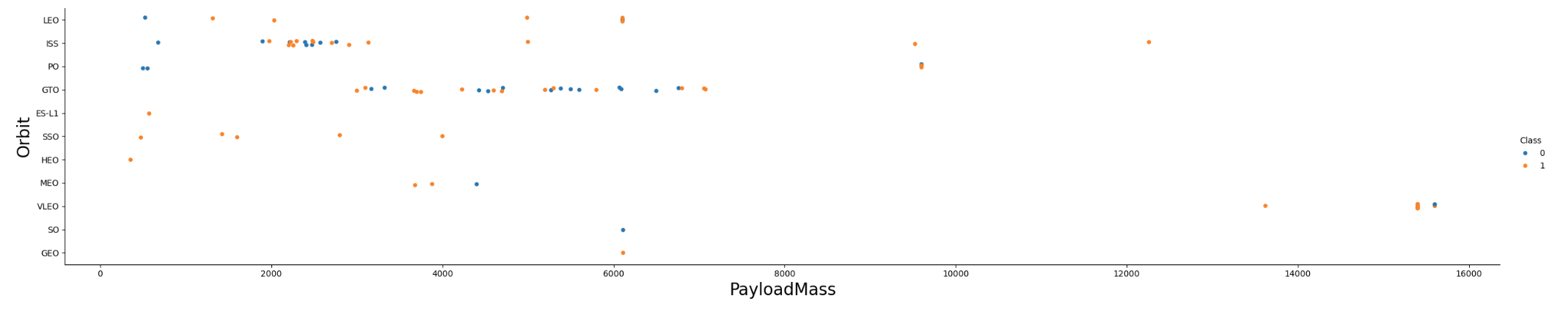
Payload vs. Orbit Type
Show a scatter point of payload vs. orbit type
Show the screenshot of the scatter plot with explanations

Slide 23
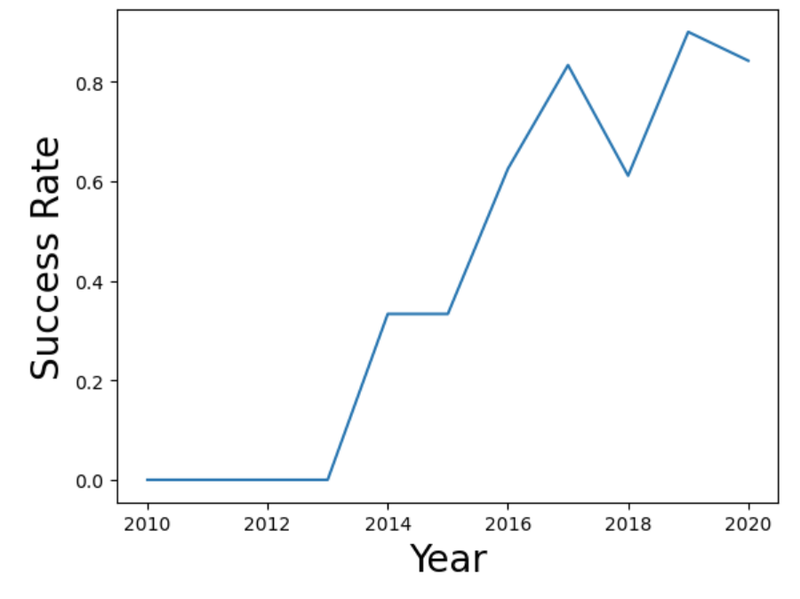
Launch Success Yearly Trend
Show a line chart of yearly average success rate
Show the screenshot of the scatter plot with explanations

Slide 24

All Launch Site Names
Find the names of the unique launch sites
Present your query result with a short explanation here

Slide 25

Launch Site Names Begin with 'CCA'
Find 5 records where launch sites begin with `CCA`
Present your query result with a short explanation here

Slide 26

Total Payload Mass
Calculate the total payload carried by boosters from NASA
Present your query result with a short explanation here

Slide 27

Average Payload Mass by F9 v1.1
Calculate the average payload mass carried by booster version F9 v1.1
Present your query result with a short explanation here

Slide 28

First Successful Ground Landing Date
Find the dates of the first successful landing outcome on ground pad
Present your query result with a short explanation here

Slide 29

Successful Drone Ship Landing with Payload between 4000 and 6000
List the names of boosters which have successfully landed on drone ship and had payload mass greater than 4000 but less than 6000
Present your query result with a short explanation here

Slide 30

Total Number of Successful and Failure Mission Outcomes
Calculate the total number of successful and failure mission outcomes
Present your query result with a short explanation here

Slide 31

Boosters Carried Maximum Payload
List the names of the booster which have carried the maximum payload mass
Present your query result with a short explanation here

Slide 32

2015 Launch Records
List the failed landing_outcomes in drone ship, their booster versions, and launch site names for in year 2015
Present your query result with a short explanation here

Slide 33

Rank Landing Outcomes Between 2010-06-04 and 2017-03-20
Rank the count of landing outcomes (such as Failure (drone ship) or Success (ground pad)) between the date 2010-06-04 and 2017-03-20, in descending order
Present your query result with a short explanation here

Slide 34

Section 3

Slide 35
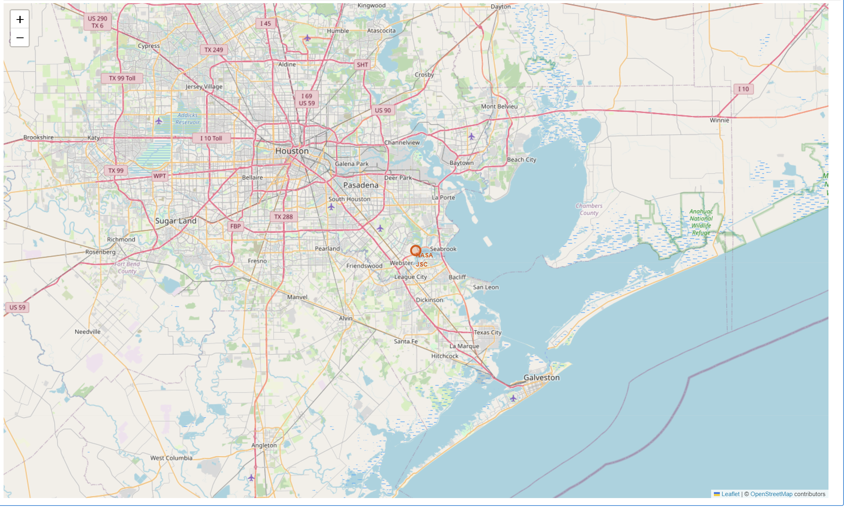
All launch sites global map markers

Slide 36
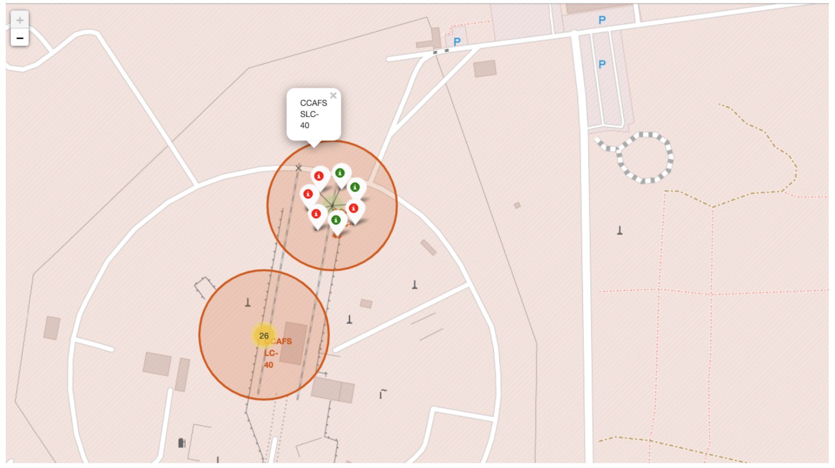
Markers showing launch sites with color labels

Slide 37
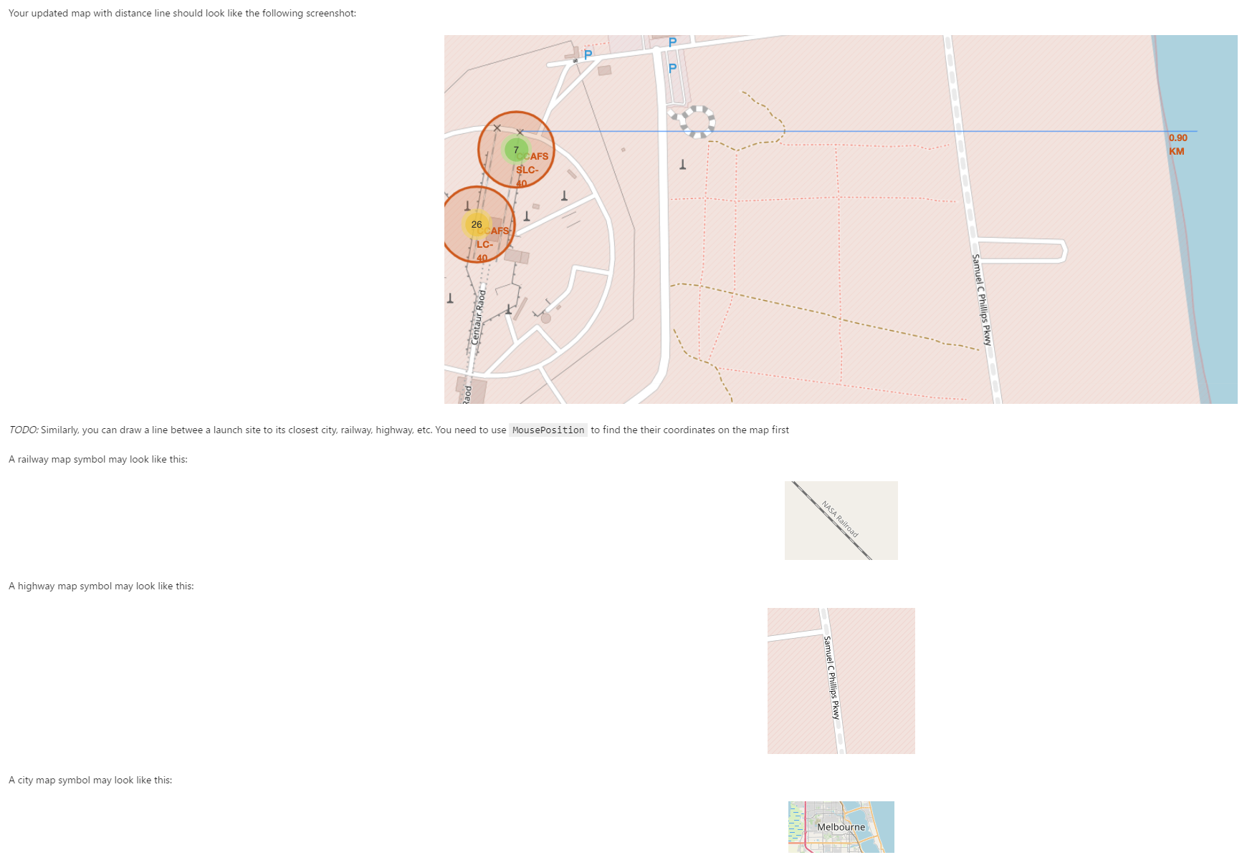
Launch Site distance to landmarks

Slide 38

Section 4

Slide 39

Pie chart showing the success percentage achieved by each launch site

Slide 40

Pie chart showing the Launch site with the highest launch success ratio

Slide 41

Section 5

Slide 42
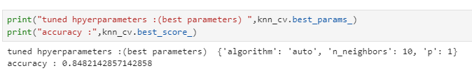
Classification Accuracy
Visualize the built model accuracy for all built classification models, in a bar chart
Find which model has the highest classification accuracy

Slide 43
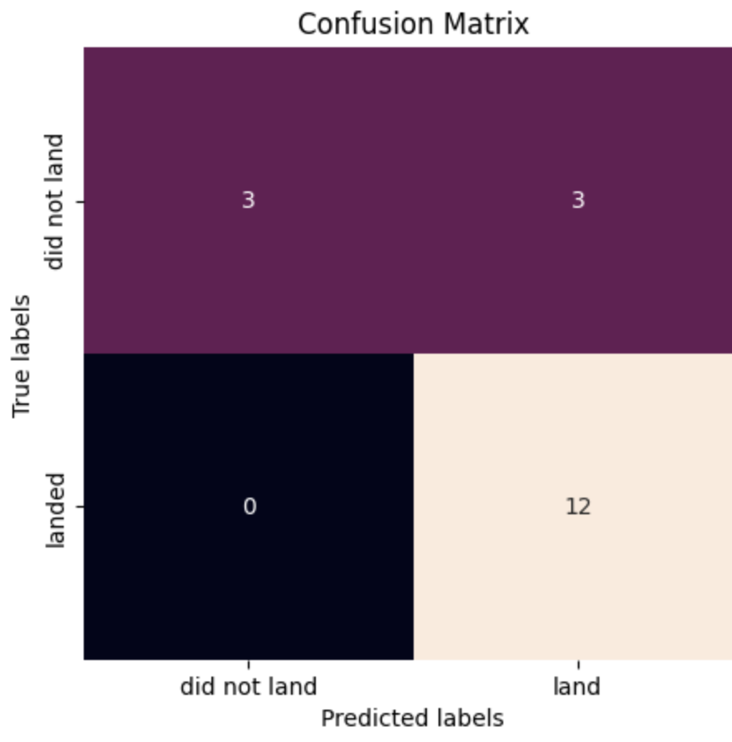
Confusion Matrix
Show the confusion matrix of the best performing model with an explanation

Slide 44
Conclusions
We can conclude that:
The larger the flight amount at a launch site, the greater the success rate at a launch site.
Launch success rate started to increase in 2013 till 2020.
Orbits ES-L1, GEO, HEO, SSO, VLEO had the most success rate.
KSC LC-39A had the most successful launches of any sites.
The Decision tree classifier is the best machine learning algorithm for this task.

Slide 45


